Slide 1
Assembly’s call for a pilgrimage

Slide 2
a pilgrimage rooted in the call for unity

Slide 3
a pilgrimage rooted in the call for unity

Slide 4
a pilgrimage of justice and peace

Slide 5
a pilgrimage of justice and peace

Slide 6
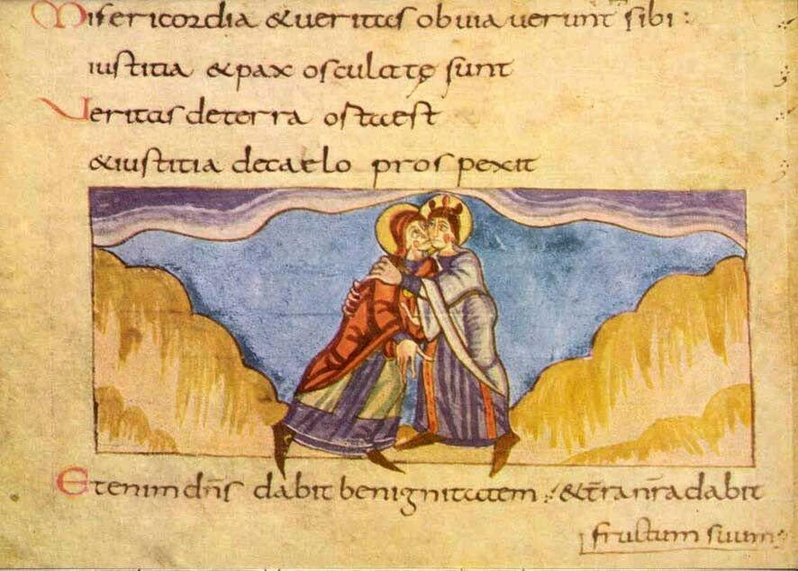
a pilgrimage of justice and peace
Stuttgarter Psalter, Ps 85:11

Slide 7
a pilgrimage of justice and peace

Slide 8
a pilgrimage of justice and peace

Slide 9
a pilgrimage of justice and peace

Slide 10
the role of the WCC in the pilgrimage

Slide 11
WCC as a facilitating actor in the pilgrimage: strategic objectives 2014-2021
strengthening the fellowship
witnessing together
encouraging spirituality, reflection and formation
communicating innovatively and inspiring
building relations of trust and understanding

Slide 12
Strategic objective 1: where do we want to be in 2021?
Strengthening the fellowship
The WCC is a strong fellowship of churches, listening, learning, celebrating and witnessing together in a pilgrimage of justice and peace, through the systematic involvement and accountability of member churches and ecumenical partners in the planning and implementation of joint work on unity and mission, public witness and diakonia, and ecumenical formation.
Witnessing together
Encouraging spirituality, reflection and formation
Building relations of trust and understanding
Communicating innovatively and inspiring

Slide 13
Strategic objective 2: where do we want to be in 2021?
Strengthening the fellowship
The WCC has a strong and effective public voice in promoting justice and building peace through accompaniment of member churches and ecumenical partners and doing advocacy on behalf of and with them at international and national levels.
Witnessing together
Encouraging spirituality, reflection and formation
Building relations of trust and understanding
Communicating innovatively and inspiring

Slide 14
Strategic objective 3: where do we want to be in 2021?
Strengthening the fellowship
The WCC, member churches and ecumenical partners have a strong spirituality of pilgrimage of justice and peace through prayer, biblical and theological reflection and ecumenical formation.
Witnessing together
Encouraging spirituality, reflection and formation
Building relations of trust and understanding
Communicating innovatively and inspiring

Slide 15
Strategic objective 4: where do we want to be in 2021?
Strengthening the fellowship
The WCC has strong relations of trust and understanding with churches that are not member and their related organisations, with representatives of other religions and with international institutions as an important aspect of the pilgrimage of justice and peace.
Witnessing together
Encouraging spirituality, reflection and formation
Building relations of trust and understanding
Communicating innovatively and inspiring

Slide 16
Strategic objective 5: where do we want to be in 2021?
Strengthening the fellowship
The WCC is an effective communication actor for the promotion of the strategic objectives and a platform for sharing stories and voices from its member churches and ecumenical partners, enhancing an understanding of the pilgrimage of justice and peace, inspiring them to join, and raising the fellowship’s visibility and public role in the ecumenical work.
Witnessing together
Encouraging spirituality, reflection and formation
Building relations of trust and understanding
Communicating innovatively and inspiring

Slide 17
Strategic objectives as pilgrimage aspects: inter-related
strengthening the fellowship
witnessing together
encouraging spirituality, reflection and formation
communicating innovatively and inspiring
building relations of trust and understanding

Slide 18
strengthening the fellowship
witnessing together
building relations of trust and understanding
Pilgrimage of justice and peace
communicating innovatively and inspiring
encouraging spirituality, reflection and formation

Slide 19
programme areas
Pilgrimage of Justice and Peace
Strategic objectives
encouraging spirituality, reflection and formation
building trust and understanding
Communicating innovatively and
inspiring
strengthening the
fellowship
witnessing
together
Transversal
priorities
Relations with member churches, NCCs and REOs
Youth engagement in the ecumenical movement
Community of women and men
Inter-religious dialogue and cooperation
Spiritual Life
Commissions
Faith & Order
Unity
Public Witness
CWME
Mission
Ecumenical Formation
CCIA
Diakonia
EEF
Ecumenical Relations
ECHOS

Slide 20
Unity, Mission and Ecumenical Relations
Unity, Mission and Ecumenical Relations
Unity / Faith and Order: reception of and reflection on The Church, moral discernment, renewal, week of prayer for Christian unity
Mission and evangelism: New mission affirmation; Evangelism in secularised societies; Christian witness in a multi-religious world; Mission from the margins (Indigenous Peoples migrant churches and EDAN)
Ecumenical relations: Relations with RCC, Pentecostal and evangelical churches, CWCs, GCF
Public Witness and Diakonia
Ecumenical Formation

Slide 21
Public Witness and Diakonia
Advocacy: Reflections on advocacy and human rights; Strategic initiatives for advocacy
Peace building: Conflict transformation and reconciliation; Accompaniment and coordination for peace in Palestine and Israel (including EAPPI)
Economic and ecological justice; Economy of life for all now; Climate change; Ecumenical Water Network (EWN)
Human dignity: Advancing peace through social justice; Diakonia and human dignity; Health and human dignity; Ecumenical HIV and AIDS initiatives and Advocacy (EHAIA)
Unity, Mission and Ecum. Rel.
Public Witness and Diakonia
Ecumenical Formation

Slide 22
Ecumenical formation
Unity, Mission and Ecum. Rel.
Public Witness and Diakonia
Ecumenical Theological Education (ETE);
Continuing ecumenical formation in different contexts focussing on ecumenical leadership (seminars, GETI, resource development, etc.);
Formal ecumenical theological education programmes at Bossey.
Ecumenical Formation

Slide 23
a pilgrimage of justice and peace

